Slide 1

Biodiversity I – intro, definitions, and why it matters
Petr Keil
Notes:
Hi, my name is Petr Keil and this is my project Biodiversity dynamics across a continuum of space, time, and their scales.

Slide 2
History, general concepts, definitions
“Biodiversity is a charismatic mega-category” (Díaz & Malhi 2022)
Notes:
I am qualified to deliver all this

Slide 3
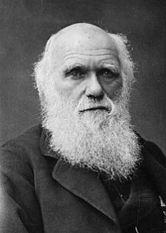
Biodivesity – a one-slide history of the concept
Charles Darwin – the Entangled Bank
Darwin (1859) On the Origin of Species.
3
Notes:
In this panel we can probably all agree that biodiversity is one of the most valuable natural resources.
But things like climate change or habitat loss are a threat to biodiversity, to the extent that we hear about biodiversity crisis, or sixth mass extinction
For example, about 1% of vertebrate species have gone extinct because of humans

Slide 4
Biodivesity – a one-slide history of the concept
1916 – J. Arthur Harris used concept of biological diversity in natural history of US deserts
1980 – The term in its current meaning in T.E. Lovejoy’s book on conservation biology
Throughout the 80’: Folks like W.G. Rosen, E. Norse, E.O. Wilson raise the term to prominence. Also, it’s generalized to “biological variability among, and also below and beyond, the level of species”
1992 – United Nations Conference of Environment and Development (the Rio summit)
1993 – United Nations Convention on Biological Diversity (CBD), Article 2: “the variability among living organisms from all sources including, inter alia, terrestrial, marine, and the ecological complexes of which they are part: this includes diversity within species, between species, and of ecosystems”
Current IPBES definition: “The variability among living organisms from all sources including terrestrial, marine and other aquatic ecosystems and the ecological complexes of which they are part. This includes variation in genetic, phenotypic, phylogenetic, and functional attributes, as well as changes in abundance and distribution over time and space within and among species, biological communities, and ecosystems”
“variation of life at all levels of biological organization” (Gaston & Spicer 2009)
Díaz & Malhi (2022) Annual Review of Environment and Rsources
Notes:
In this panel we can probably all agree that biodiversity is one of the most valuable natural resources.
But things like climate change or habitat loss are a threat to biodiversity, to the extent that we hear about biodiversity crisis, or sixth mass extinction
For example, about 1% of vertebrate species have gone extinct because of humans

Slide 5
The diversity of biodiversities – biodiversity is multidimensional
Across many species
Taxonomic diversity – number of species
Phylogenetic diversity – diversity which incorporates phylogenetic (evolutionary) difference between species
Functional diversity – range of functional traits
Within a single species
Genetic diversity – number of genetic characteristics of a species (i.e. combined differences in the DNA of all individuals of a species)
Morphological diversity
Phenotypic plasticity - the ability of individual genotypes to produce different phenotypes when exposed to different environmental conditions
Landscape
Ecosystem or habitat diversity, resource diversity
Notes:
In this panel we can probably all agree that biodiversity is one of the most valuable natural resources.
But things like climate change or habitat loss are a threat to biodiversity, to the extent that we hear about biodiversity crisis, or sixth mass extinction
For example, about 1% of vertebrate species have gone extinct because of humans

Slide 6
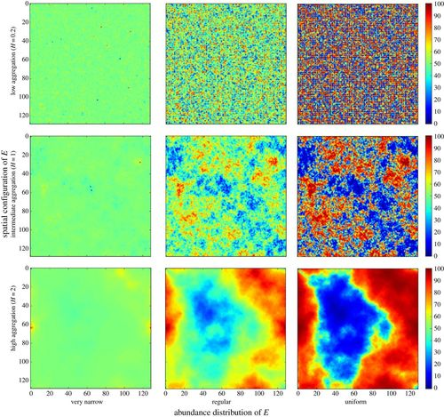
Closely related concepts: Heterogeneity, variability, complexity
Bar Massada et al. (2014) Proceedings of the Royal Society B
Notes:
In this panel we can probably all agree that biodiversity is one of the most valuable natural resources.
But things like climate change or habitat loss are a threat to biodiversity, to the extent that we hear about biodiversity crisis, or sixth mass extinction
For example, about 1% of vertebrate species have gone extinct because of humans

Slide 7
Remotely sensed habitat heterogeneity
Free GIS layers on EarthEnv, Tuanmu & Jetz (2015) Global Ecology and Biogeography
Notes:
In this panel we can probably all agree that biodiversity is one of the most valuable natural resources.
But things like climate change or habitat loss are a threat to biodiversity, to the extent that we hear about biodiversity crisis, or sixth mass extinction
For example, about 1% of vertebrate species have gone extinct because of humans

Slide 8
Measuring biodiversity
Notes:
I am qualified to deliver all this

Slide 9
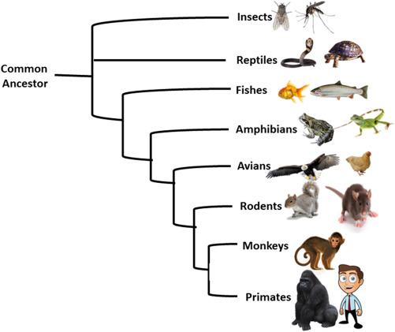
Number of species (Taxonomic diversity) vs Phylogenetic diversity
Community
Image: Nixon (2001) Encyclopedia of Biodiversity
Notes:
In this panel we can probably all agree that biodiversity is one of the most valuable natural resources.
But things like climate change or habitat loss are a threat to biodiversity, to the extent that we hear about biodiversity crisis, or sixth mass extinction
For example, about 1% of vertebrate species have gone extinct because of humans

Slide 10
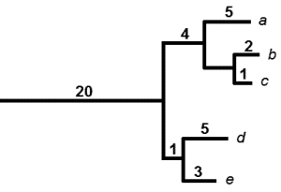
Faith’s phylogenetic diversity (PD)
PD = sum of branch lengths = 20 + 5 + 4 + 2 + 1 + 5 + 1 + 3
Faith (1992) Biological Conservation
Notes:
In this panel we can probably all agree that biodiversity is one of the most valuable natural resources.
But things like climate change or habitat loss are a threat to biodiversity, to the extent that we hear about biodiversity crisis, or sixth mass extinction
For example, about 1% of vertebrate species have gone extinct because of humans

Slide 11
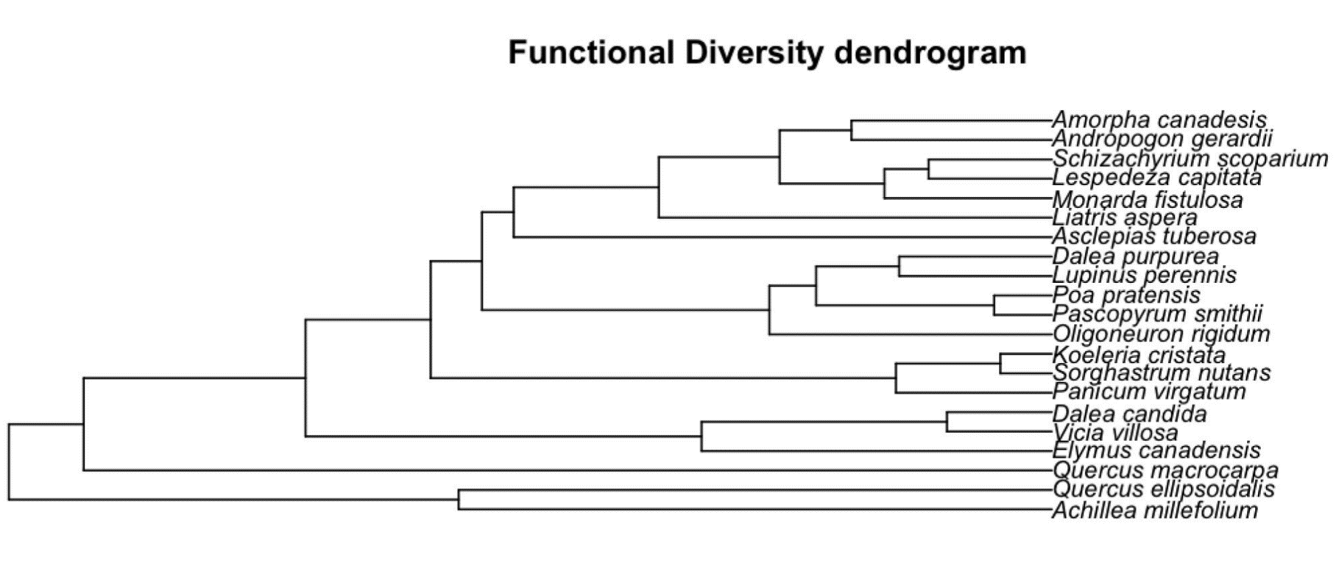
Functional diversity (FD)
FD = sum of branch lengths
Dissimilarity of functional traits
Notes:
In this panel we can probably all agree that biodiversity is one of the most valuable natural resources.
But things like climate change or habitat loss are a threat to biodiversity, to the extent that we hear about biodiversity crisis, or sixth mass extinction
For example, about 1% of vertebrate species have gone extinct because of humans

Slide 12
Note
Taxonomic, phylogenetic, and functional diversity are correlated!
Notes:
In this panel we can probably all agree that biodiversity is one of the most valuable natural resources.
But things like climate change or habitat loss are a threat to biodiversity, to the extent that we hear about biodiversity crisis, or sixth mass extinction
For example, about 1% of vertebrate species have gone extinct because of humans

Slide 13
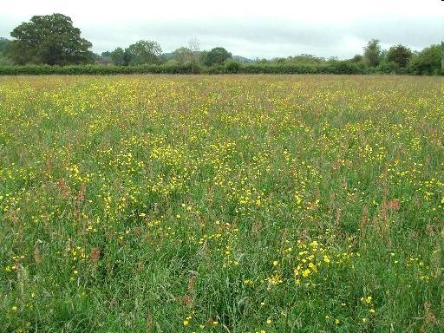
Incidence vs abundance-based diversity
Species | Abundance (# of individuals) | Incidence
Phleum pratense | 25 | 1
Ranunculus acris | 20 | 1
Dactylis glomerata | 10 | 1
Taraxacum officinale | 8 | 1
Veronica chamaedris | 3 | 1
Trifolium hybridum | 2 | 1
Lotus corniculatus | 1 | 1
Lathyrus pratensis | 1 | 1
Vicia villosa | 0 | 0
Anthoxanthum odoratum | 0 | 0
Poa annua | 0 | 0
Community
Notes:
In this panel we can probably all agree that biodiversity is one of the most valuable natural resources.
But things like climate change or habitat loss are a threat to biodiversity, to the extent that we hear about biodiversity crisis, or sixth mass extinction
For example, about 1% of vertebrate species have gone extinct because of humans

Slide 14
Species-abundance distribution
Rank-abundance diagram
Histogram
Notes:
In this panel we can probably all agree that biodiversity is one of the most valuable natural resources.
But things like climate change or habitat loss are a threat to biodiversity, to the extent that we hear about biodiversity crisis, or sixth mass extinction
For example, about 1% of vertebrate species have gone extinct because of humans

Slide 15
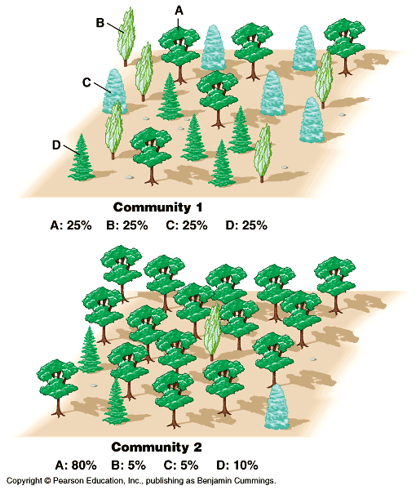
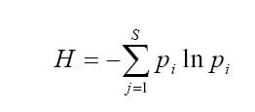
Abundance-based indices of diversity
Shannon-Wiener index:
Species rank
Species rank
Notes:
In this panel we can probably all agree that biodiversity is one of the most valuable natural resources.
But things like climate change or habitat loss are a threat to biodiversity, to the extent that we hear about biodiversity crisis, or sixth mass extinction
For example, about 1% of vertebrate species have gone extinct because of humans

Slide 16
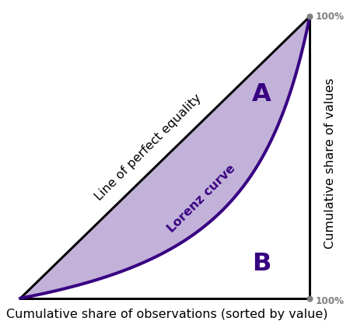
Evenness
Gini index G = A / (A+B)
Species rank
Species rank
Gini Graphs: Kimberley Fessel
Notes:
In this panel we can probably all agree that biodiversity is one of the most valuable natural resources.
But things like climate change or habitat loss are a threat to biodiversity, to the extent that we hear about biodiversity crisis, or sixth mass extinction
For example, about 1% of vertebrate species have gone extinct because of humans

Slide 17
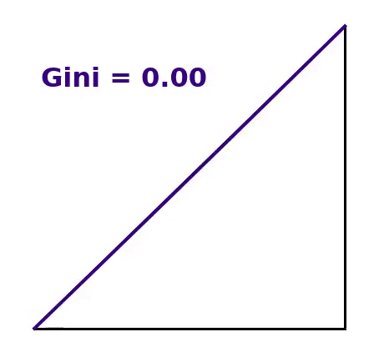
Evenness
Gini index G = A / (A+B)
Species rank
Species rank
Gini Graphs: Kimberley Fessel
Notes:
In this panel we can probably all agree that biodiversity is one of the most valuable natural resources.
But things like climate change or habitat loss are a threat to biodiversity, to the extent that we hear about biodiversity crisis, or sixth mass extinction
For example, about 1% of vertebrate species have gone extinct because of humans

Slide 18
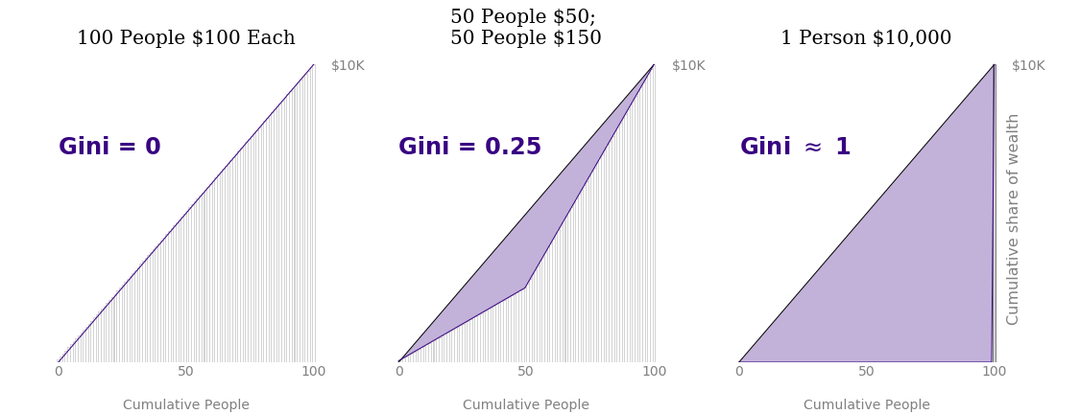
Evenness
Gini Graphs: Kimberley Fessel
Notes:
In this panel we can probably all agree that biodiversity is one of the most valuable natural resources.
But things like climate change or habitat loss are a threat to biodiversity, to the extent that we hear about biodiversity crisis, or sixth mass extinction
For example, about 1% of vertebrate species have gone extinct because of humans

Slide 19
Alpha, beta, and gamma diversity
α
γ
β = γ/α
Whittaker R. H. (1960) Ecological Monographs
Notes:
In this panel we can probably all agree that biodiversity is one of the most valuable natural resources.
But things like climate change or habitat loss are a threat to biodiversity, to the extent that we hear about biodiversity crisis, or sixth mass extinction
For example, about 1% of vertebrate species have gone extinct because of humans

Slide 20
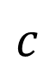
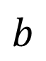
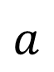
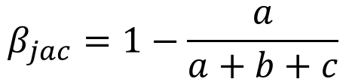
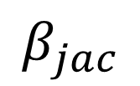
Similarity (or dissimilarity) – more than 80 indices for binary data
Example: Jaccard index
$$β_{jac}=1−\frac{a}{a+b+c}$$
$$a$$
$$b$$
$$c$$
$$β_{jac}$$
1
1
1
1
1
1
Sites
1
1
1
1
Species
Koleff et al. (2003) Journal of Animal Ecology
Legendre & Legendre (2012) Numerical Ecology
Notes:
In this panel we can probably all agree that biodiversity is one of the most valuable natural resources.
But things like climate change or habitat loss are a threat to biodiversity, to the extent that we hear about biodiversity crisis, or sixth mass extinction
For example, about 1% of vertebrate species have gone extinct because of humans

Slide 21
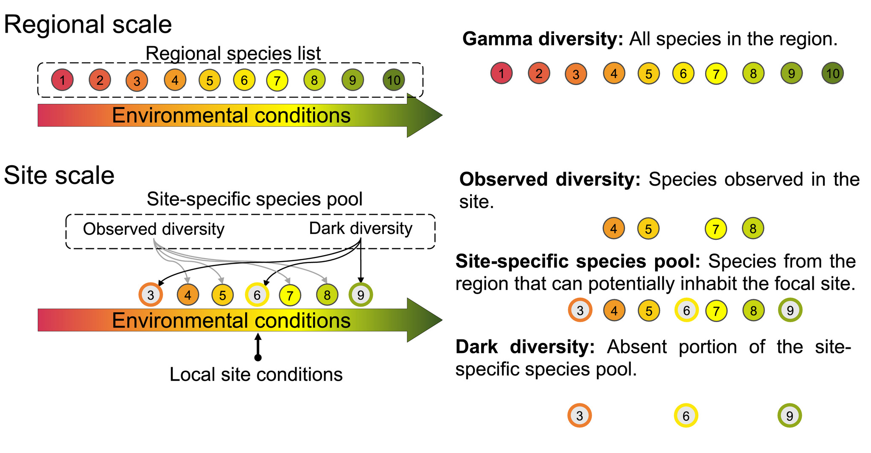
Species pools, dark diversity
Carmona & Partel (2021) Global Ecology & Biogeography
Notes:
In this panel we can probably all agree that biodiversity is one of the most valuable natural resources.
But things like climate change or habitat loss are a threat to biodiversity, to the extent that we hear about biodiversity crisis, or sixth mass extinction
For example, about 1% of vertebrate species have gone extinct because of humans

Slide 22
You should know
The difference between taxonomic, phylogenetic, and functional diversity
How are these measured (species richness, FD, PD)
The difference between abundance-based and incidence-based metrics
What is species-abundance distribution
The difference between diversity and evenness
What is alpha, beta, and gamma diversity
What are species pools
Notes:
In this panel we can probably all agree that biodiversity is one of the most valuable natural resources.
But things like climate change or habitat loss are a threat to biodiversity, to the extent that we hear about biodiversity crisis, or sixth mass extinction
For example, about 1% of vertebrate species have gone extinct because of humans

Slide 23
Why biodiversity matters
Notes:
I am qualified to deliver all this

Slide 24
Two views on why biodiversity matters
Biocentric views
favor intrinsic values
unrelated to humans
entities irreplaceable
Championed by nature lovers and conservationists
-> Ecosystem function, functional traits
Anthropocentric views
favors human-focused values
strongly instrumental
entities often seem replaceable
-> Ecosystem services, Nature’s contribution to people
Díaz & Malhi (2022) Annual Review of Environment and Rsources
Notes:
In this panel we can probably all agree that biodiversity is one of the most valuable natural resources.
But things like climate change or habitat loss are a threat to biodiversity, to the extent that we hear about biodiversity crisis, or sixth mass extinction
For example, about 1% of vertebrate species have gone extinct because of humans

Slide 25
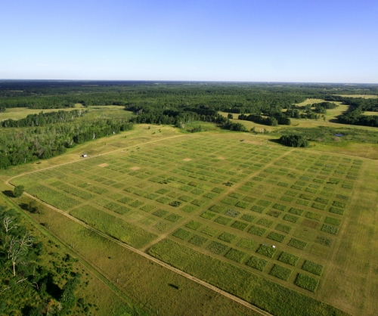
Biodiversity-ecosystem function (BEF): productivity
Loreau et al. (2001) Science
Notes:
In this panel we can probably all agree that biodiversity is one of the most valuable natural resources.
But things like climate change or habitat loss are a threat to biodiversity, to the extent that we hear about biodiversity crisis, or sixth mass extinction
For example, about 1% of vertebrate species have gone extinct because of humans

Slide 26
Biodiversity effects: productivity
Complementarity – each species has different sets of traits, and exploits different niche
Sampling effect – the more species we sample from species pool, the higher the chance that we sample a productive one
Loreau et al. (2001) Science
Notes:
In this panel we can probably all agree that biodiversity is one of the most valuable natural resources.
But things like climate change or habitat loss are a threat to biodiversity, to the extent that we hear about biodiversity crisis, or sixth mass extinction
For example, about 1% of vertebrate species have gone extinct because of humans

Slide 27
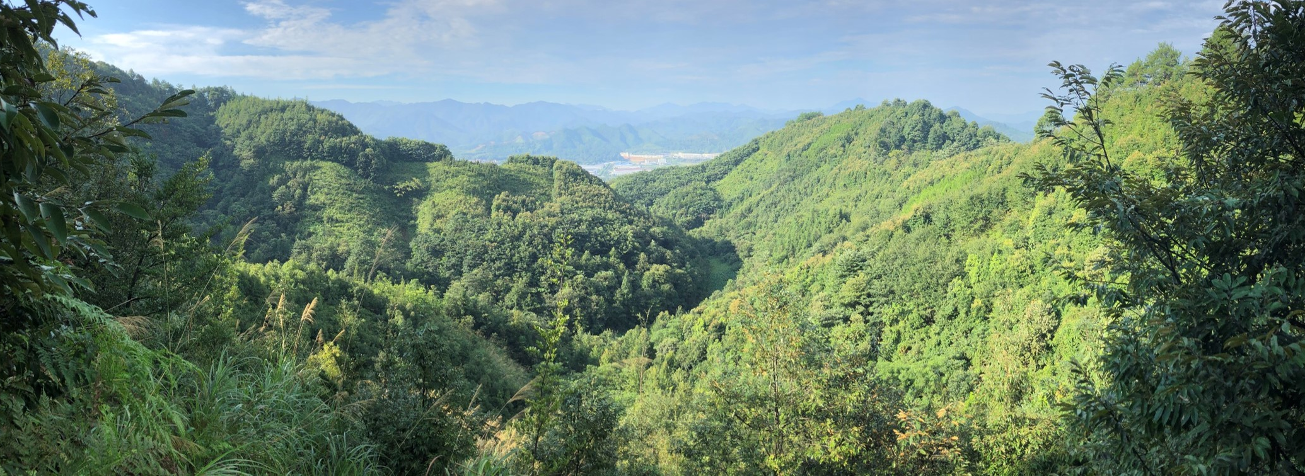
BEF in Chinese subtropical forest experiment
Huang et al. (2018) Science
bef-china.com
Notes:
In this panel we can probably all agree that biodiversity is one of the most valuable natural resources.
But things like climate change or habitat loss are a threat to biodiversity, to the extent that we hear about biodiversity crisis, or sixth mass extinction
For example, about 1% of vertebrate species have gone extinct because of humans

Slide 28
BEF in global observational data
Duffy et al. (2017) Nature
Notes:
In this panel we can probably all agree that biodiversity is one of the most valuable natural resources.
But things like climate change or habitat loss are a threat to biodiversity, to the extent that we hear about biodiversity crisis, or sixth mass extinction
For example, about 1% of vertebrate species have gone extinct because of humans

Slide 29
Biodiversity-ecosystem function (BEF): stability
Initial treatment species number
Tilman, Reich & Knops (2006) Nature
Notes:
In this panel we can probably all agree that biodiversity is one of the most valuable natural resources.
But things like climate change or habitat loss are a threat to biodiversity, to the extent that we hear about biodiversity crisis, or sixth mass extinction
For example, about 1% of vertebrate species have gone extinct because of humans

Slide 30
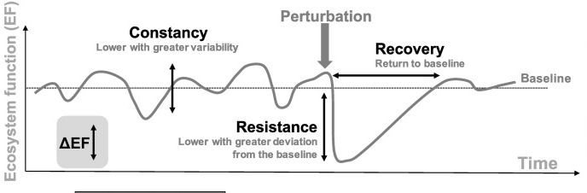
Biodiversity effects: stability
De Bello et al. (2021) Trends in Ecology and Evolution
Notes:
In this panel we can probably all agree that biodiversity is one of the most valuable natural resources.
But things like climate change or habitat loss are a threat to biodiversity, to the extent that we hear about biodiversity crisis, or sixth mass extinction
For example, about 1% of vertebrate species have gone extinct because of humans

Slide 31
Mechanisms: stability
Three main mechanisms behind biodiversity-stability relationship :
Asynchrony of species responses to environmental fluctuations
Differences at speed at which species respond to perturbations
Reduction in the strength of competition
Loreau & Mazancourt (2013) Ecology Letters
Notes:
In this panel we can probably all agree that biodiversity is one of the most valuable natural resources.
But things like climate change or habitat loss are a threat to biodiversity, to the extent that we hear about biodiversity crisis, or sixth mass extinction
For example, about 1% of vertebrate species have gone extinct because of humans

Slide 32
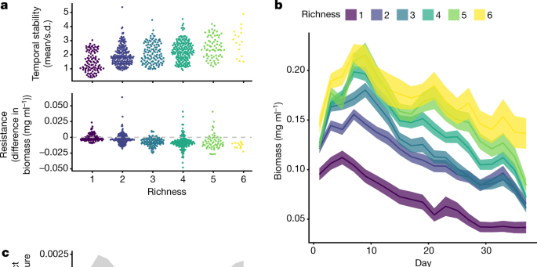
Empirical support for biodiversity-stability relationship: it is complicated
Pennekamp et al. (2018) Nature
Notes:
In this panel we can probably all agree that biodiversity is one of the most valuable natural resources.
But things like climate change or habitat loss are a threat to biodiversity, to the extent that we hear about biodiversity crisis, or sixth mass extinction
For example, about 1% of vertebrate species have gone extinct because of humans

Slide 33
You should know
There is a prevalent (empirically and experimentally supported) positive biodiversity-productivity relationship
The main mechanisms behind it are:
Higher likelihood of having (sampling) a high-productivity species if we sample species from species pool
Complementarity effects
There are multiple relationships between biodiversity and stability, depending on how we define stability, and the whole science behind biodiversity-stability relationship is quite complex
Notes:
In this panel we can probably all agree that biodiversity is one of the most valuable natural resources.
But things like climate change or habitat loss are a threat to biodiversity, to the extent that we hear about biodiversity crisis, or sixth mass extinction
For example, about 1% of vertebrate species have gone extinct because of humans

Slide 34
Thank you. Questions?

